Slide 1
Descriptive Writing
Use it in the following types of writing: Stories (Narrative), Poetry, Essays, Personal Letters, Emails, Texts, Facebook Posts, Instagrams, Tweets, and the list goes on and on and on

Slide 2
Follow- Up to I’m From Grade 10 Only
Take the “I’m From” poem written by Mr. Jeffrey Matheson
Read it.
Identify the following by labelling it in the column titled “Image or Device” with the appropriate term:
Alliteration, Allusion, Foreshadowing, Hyperbole, Metaphor, Onomatopoeia, Personification, Simile
In the second column “What is being Describe(d)” – He made a spelling mistake… Explain what the device is trying to say.

Slide 3
Why do we need the Descriptive?
Most writing we will do has a tendency to be plain. We rush our text messages to our friends and say things in as few letters (words) as possible.
We often forget that our language is meant to be a beautiful thing.
It means that you take this:
It was morning and it was golden perfection, in shimmering waves of light. The sky was exalting the magnificence of creation in its many varied shades of blues, azures, and deep cobalt. The sand shone, and glinted crystals of light in all directions. And it was warm like a towel fresh from a dryer; the kind of warm that comforts you with its perfection. The wind was a sweet caress; a loving hand that soothes. I sat in the soft, silken sand of that Caribbean paradise and cradled a book in my hands - The Historian – and it told me a story of a time long ago, in whispered tones.

Slide 4
Why do we need Descriptive?
It means that you take this:
It was morning and it was golden perfection, in shimmering waves of light. The sky was exalting the magnificence of creation in its many varied shades of blues, azures, and deep cobalt. The sand shone, and glinted crystals of light in all directions. And it was warm like a towel fresh from a dryer; the kind of warm that comforts you with its perfection. The wind was a sweet caress; a loving hand that soothes. I sat in the soft, silken sand of that Caribbean paradise and cradled a book in my hands - The Historian – and it told me a story of a time long ago, in whispered tones.
And it becomes this:
It was a beautiful day. The sky was blue. The sand was brown, and it was warm. There was a little wind. I sat on the nice sand, reading a book.
Or worse:
It was a day. The sky was. The sand was. There was wind. I sat on the sand, reading a book.

Slide 5
How does that even come close to this:

Slide 6
What do you need for Descriptive Language?
Vocabulary: splendor, radiant, shimmer, exquisite, searing, catastrophe, brilliant, blazing, devastating, feeble, transcendent, harsh, lustrous, pristine, dank, incendiary, horrendous, dreary.
You need a strong vocab. to make your ideas stand out. If you don’t have one? Read books to improve it, keep a journal of the cool words you find, or use a thesaurus. CAUTION: make sure the word in the thesaurus means what you want it to. There are shades of meaning.
Figurative Language: Alliteration, Allusion, Foreshadowing, Hyperbole, Metaphor, Onomatopoeia, Personification, and Simile.
Use it to make comparisons to things that people will understand. This will deepen the meaning.
The best ones to use are in bold.

Slide 7
Now your task?
Take this paragraph:
It was a beautiful day. The sky was blue. The sand was brown, and it was warm. There was a little wind. I sat on the nice sand, reading a book.
And, to paraphrase The Beatles: “Take a sad [piece of writing], and make it better.”
Or, in other words, use strong vocabulary, and figurative language to improve the piece of writing into a paragraph worthy of reading, and hand it in.
Figurative Language: Alliteration, Allusion, Foreshadowing, Hyperbole, Metaphor, Onomatopoeia, Personification, and Simile.

Slide 8
GRADE 10 only: A Second Task if you finish the First Or if you are wasting time and require double homework.
Revisit your “I’m From” poem and do the following:
Improve the use of Figurative Language present, or add figurative language to your poems.
Accurately label the figurative language used in your “I’m From” poems.

Slide 9
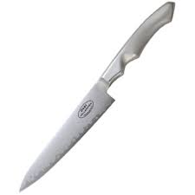
Lesson 2: Descriptive Language in Social Media
People use Descriptive to Sell things:
Gillette, the best a man can get. (Best is a quality)
I’m Lovin’ It. (Lovin’)
People use descriptive to explain emotions:
Your words cut like a knife. (Simile)Not actually cutting me.
Her beauty was breathtaking. (Hyperbole) My breath was not actually taken.
That blew my mind. (Metaphor/Hyperbole) Mind still in one piece.

Slide 10
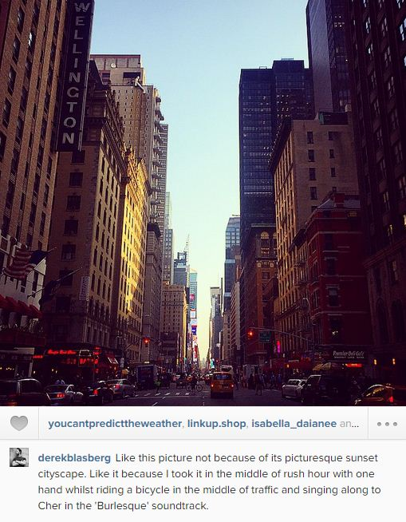
On Instagram
@derekblasberg says:
“Like this picture not because of its picturesque sunset cityscape. Like it because I took it in the middle of rush hour with one hand whilst riding a bicycle on the middle of traffic and singing along to Cher in the ‘Burlesque’ soundtrack.”
Write down on a sheet of paper and good/new words, or phrases that you think describe something. (2 mins)
Now check with a partner and compare. (1 min)
Now between the two of you, share one example. (2 mins max)

Slide 11
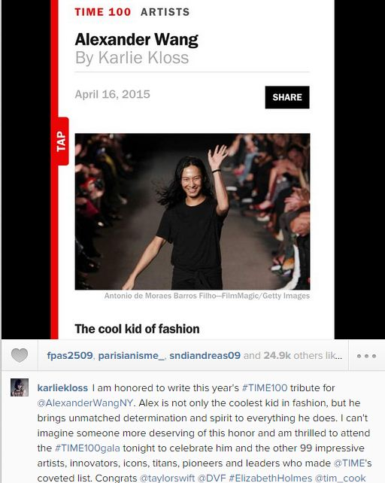
Another example from Instagram
Karliekloss I am honored to write this year's #TIME100 tribute for@AlexanderWangNY. Alex is not only the coolest kid in fashion, but he brings unmatched determination and spirit to everything he does. I can't imagine someone more deserving of this honor and am thrilled to attend the #TIME100gala tonight to celebrate him and the other 99 impressive artists, innovators, icons, titans, pioneers and leaders who made @TIME's coveted list. Congrats @taylorswift @DVF #ElizabethHolmes @tim_cook@MalalaFund @EmmaWatson @kimkardashian @mistyonpointe (and many more!)

Slide 12
Imagine these posts without description
I am ________to write this year's #TIME100 tribute for@AlexanderWangNY. Alex is not only the kid in fashion, but he brings ________and _______to everything he does. I can't imagine someone more ________ of this ________ and am ________ to ________ the #TIME100gala tonight to ________ him and the other 99 ________ ________, ________, ________, ________, ________ and ________ who made @TIME's ________ list.
Like this picture not because of its _______ _______ _______. Like it because I took it in the _______ of _______ _______ with one hand whilst riding a bicycle on the _______ of _______ and _______ along to Cher in the ‘Burlesque’ soundtrack.”

Slide 13
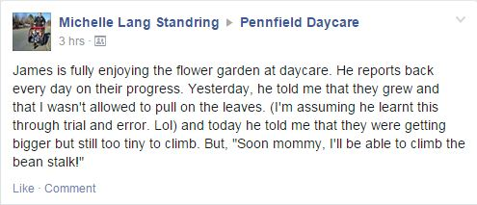
Or better yet, Facebook
Take out any and all description and what are you left with?
Try it… Take 5 minutes and a piece of looseleaf and with a partner, see what you get.

Slide 14
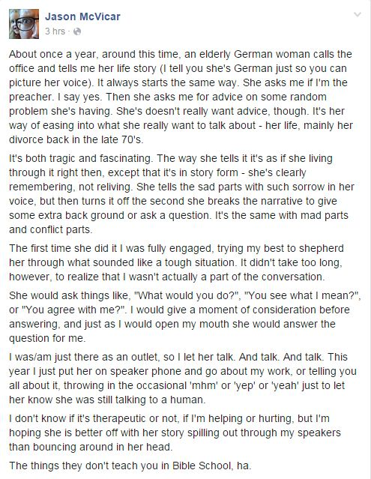
And you say people don’t use description on Facebook?!?

Slide 15
You will be given a handout of this post
Highlight any description
Highlight any figurative language
Highlight any detail that made you feel an emotion that you think the writer intended.

Slide 16
Descriptive Writing Work
Find a piece of writing on Social Media (appropriate to school) that you think is particularly good for its description.
You will share it with your group.
If you can not find one, then you must prepare a descriptive piece, similar to a post we have seen, telling a story, describing a picture, something that happened, or an emotion you/someone imaginary is feeling.

Slide 17
Descriptive Writing Work 2
Most writing we will do has a tendency to be plain. We rush our text messages to our friends and say things in as few letters (words) as possible.
We often forget that our language is meant to be a beautiful thing.
It was a dark night. The sky was black. The house was quiet. There was wind. I sat in a chair, reading a book, and then I heard a sound.
The example above is the opposite of beautiful writing.
Improving writing:
Begin by adding “SENSES” (the writing that uses our senses) descriptive writing.
Take some of the descriptive writing that could be improved and change them into similes
For those of you who will say “It’s all good, and doesn’t need improvement”, change the 1st and 3rd sentences.
Now let’s write these again by changing the similes to metaphors.
NOW: Write your own piece of descriptive writing. Make it about your ideal place/way to relax. Describe it using as many different forms of Figurative Language as you can: Alliteration, Allusion, Foreshadowing, Hyperbole, Metaphor, Onomatopoeia, Personification, Simile

