Slide 1
WE ARE ALL
TREATY PEOPLE
Notes:
Photo: open source

Slide 2
Analyze
CAUSE &
CONSEQUENCE
In examining tragedies and accomplishments, we look at the questions: how and why…It is the search for causes.
Look at:
actions, beliefs, and circumstances that led to these consequences?
Notes:
The 6 Thinking Hats of Historical Thinking

Slide 3
Treaty No.9 Commission, Commissioners land and Long Lake, ON. 1906
WE ARE ALL TREATY PEOPLE
TREATIES IN CANADA
Notes:
Photo: Treaty No.9 Commission, Commissioners land and Long Lake, ON. 1906. (From the Archives of Matawa First Nations)

Slide 4
WE ARE ALL TREATY PEOPLE
TREATIES IN CANADA
Prior to contact, North America, was populated by many nations with sophisticated ways of life and traditional territories.
A key component was the idea of treaties; and they established peaceful relationships, including trade, safe passage, peace, and respect.
Snowy Owl Whitecotton, with his daughter and his wife Leah Beaver (1906)
Notes:
Watch the Youtube video ‘Trick or Treaty?’ here: https://www.youtube.com/watch?v=g34Ty0nH8O8
Photo: Snowy Owl Whitecotton, Native American photo Sampson Beaver with his daughter, Frances Beaver, and his wife Leah Beaver - Assiniboine - 1906

Slide 5
WE ARE ALL TREATY PEOPLE
FIRST NATIONS TREATY
MAKING
First Nations had their own process of Treaty-making that had existed for thousands of years.
The ceremony and items used differed from culture to culture, but it followed a general format:
introductions, gift-giving, getting to know each other, negotiations and the formalization of the Treaty through a pipe ceremony.
After the pipe ceremony, the Treaty would then be seen as a three-party agreement between the two parties and also the Creator.
The Great Peace Treaty of Montréal, by Francis Back.
Notes:
Photo:: Depiction of the assembly of the 4th of August 1701, before the signature of the ‘Grande Paix de Montréal’ or the Great Peace Treaty of Montreal by artist Francis Back.

Slide 6
Meeting for Treaty 6 (1876)
WHAT DO TREATIES REPRESENT IN CANADA?
It is a legal agreement between Federal Government and First Nation peoples, negotiating rights, recognized by the supreme Court of Canada.
Notes:
Photo: Meeting for Treaty 6, 1876 (Glenbow Archives Na-448-6)

Slide 7
WE ARE ALL TREATY PEOPLE
TYPES OF TREATIES
Peace and Friendship Treaties
3. Pre-Confederation Treaties
2. Post-Confederation
(Numbered) Treaties
4. Modern Treaties
Notes:
Photos: 1.Depiction of the assembly of the 4th of August 1701, before the signature of the ‘Grande Paix de Montréal’ or the Great Peace Treaty of Montreal by artist Francis Back.; 2. Meeting for Treaty 6 (Glenbow Archives Na-448-6); 3. Indian Chiefs Medal, Presented to commemorate Treaty Numbers 3, 4, 5, 6, 7, 8 (Queen Victoria). Image courtesy of Library and Archives Canada Library and Archives Canada, Acc. No. 1964-1-1M.; 4. Prime Minster Stephen Harper shakes hands with Chief Wilson Littlechild after reading the Government of Canada’s Official Apology on the floor of the Parliament building. (THE CANADIAN PRESS/Fred Chartrand)

Slide 8
CHARACTERISTICS OF A VALID TREATY
Parties: Crown/First Nation
Agency: Whoever signs the treaty must have authority to bind the parties.
Intention: Parties must intend to create legally binding obligations.
Consideration: Obligations by both sides to fulfill.
Formality: A measure of solemnity (seriousness) to the signing and intent.
Two Row Wampum Treaty Belt
Notes:
Photo: Wampum Treaty Belt (courtesy of Productions Cazabon)

Slide 9
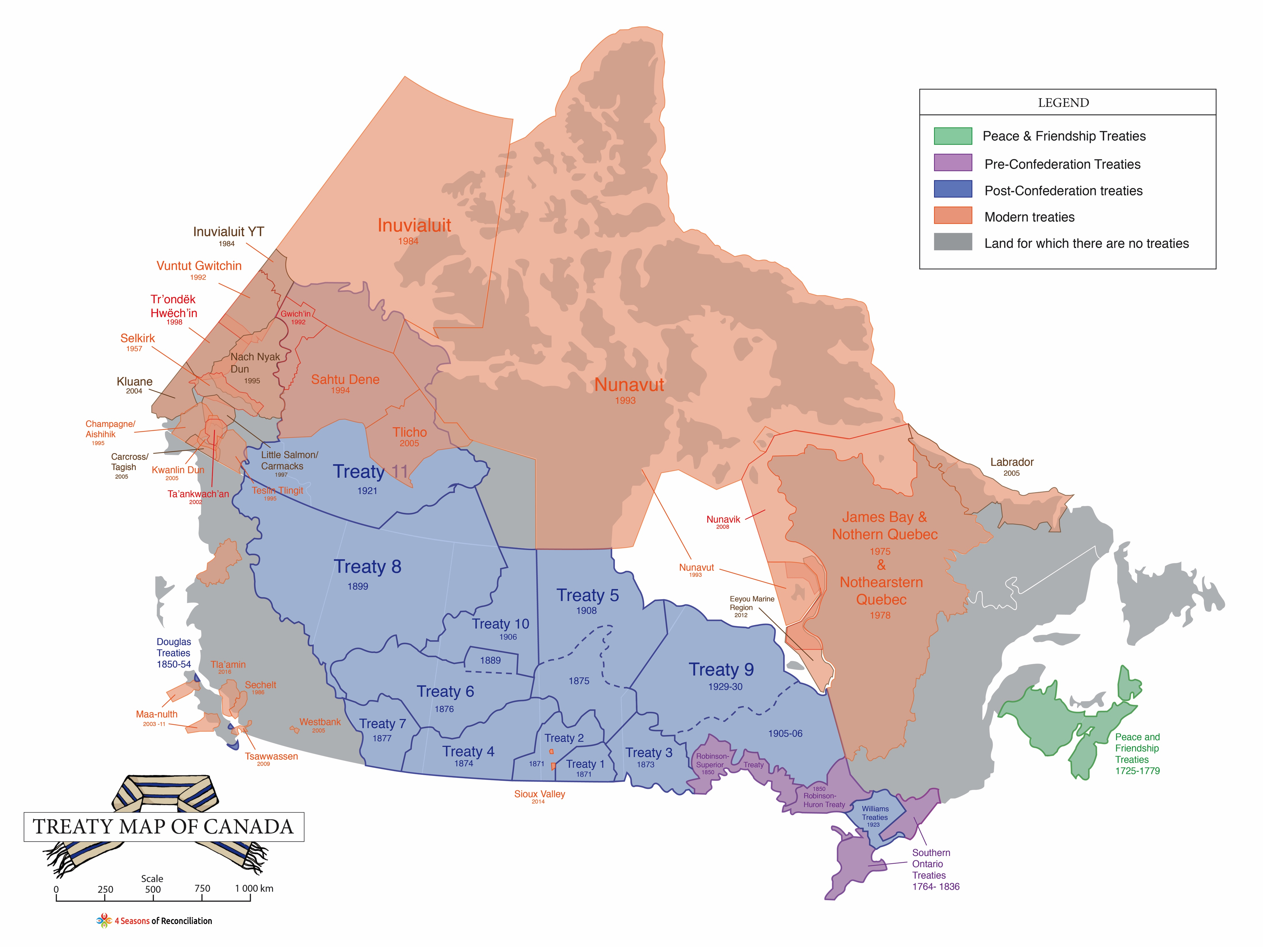

Slide 10
WE ARE ALL TREATY PEOPLE
PEACE & FRIENDSHIP
TREATIES
Signed during the 17th and 18th centuries with the French, Dutch and English.
Guarantee of hunting and fishing rights in return for peaceful relationships and military alliances.
No land cession, but still valid.
Printed Proclamation of the 1752 Peace and Friendship Treaty
Notes:
Photos: Printed Proclamation of the 1752 Treaty (Peace and Friendship Treaties Nova Scotia Archives RG 1, Vol. 430, No. 2)

Slide 11
WE ARE ALL TREATY PEOPLE
PRE-CONFEDERATION TREATIES
King George III in 1763, wrote the constitutional framework to negotiate treaties with Indigenous peoples inhabiting British North America.
This was a recognition of the power Indigenous nations held.
A common myth is that Indigenous people lost the war against Europeans. This never happened.
The truth remains that Europeans feared the impacts of fighting with the Indigenous people, and felt it wise to reassure them of land rights, with treaties.
Indian Chiefs Medal, Presented to commemorate Treaty Numbers 3, 4, 5, 6, 7, 8
Notes:
Photo: Indian Chiefs Medal, Presented to commemorate Treaty Numbers 3, 4, 5, 6, 7, 8 (Queen Victoria). Image courtesy of Library and Archives Canada Library and Archives Canada, Acc. No. 1964-1-1M.

Slide 12
WE ARE ALL TREATY PEOPLE
THE IMPORTANCE OF TREATIES FOR EUROPEANS
Without the Peace and Friendship Treaties, Canada would not be a country today; it would most likely be part of the United States.
The Oneidas at the Battle of Oriskany," by Don Troiani
Most Canadians don’t know this:
We owe our Nation to the Indigenous soldiers who fought with us against the American Settlers, in the war of 1812.
Indigenous Nations helped win the territory we call Canada through the brotherhood and loyalty founded by the Treaties.
"Battle of Tippecanoe" by Kurz & Allison
Notes:
Photo bottom right: "The Oneidas at the Battle of Oriskany," by noted historical artist Don Troiani. The painting depicts one of the bloodiest battles of the Revolutionary War, with an emphasis on the Oneidas who fought alongside the colonists as the United States' first allies against the British.
Photo top left: "Battle of Tippecanoe" by Kurz & Allison (detail) American troops under the leadership of General William Henry Harrison fighting the Indian forces of The Prophet, Tenskwatawa (the brother of Tecumseh) in a forest. Source: Libary of Congress

Slide 13
Treaty No. 2 Document
HISTORIC OR
NUMBERED TREATIES
Between 1871 and 1921, and enabled the Canadian government to pursue agriculture, settlement, transportation links and resources in West and Northern Canada.
Chiefs of the Six Nations at Brantford, ON and
their wampum belts (1871)
Called Numbered Treaties because they were numbered 1 to 11. They covered northern Ontario, Manitoba, Saskatchewan, Alberta, north-eastern British Columbia, and the Northwest Territories.
Notes:
Photo top: Treaty No. 2 (Library and Archives Canada)
Photo bottom: Chiefs of the Six Nations at Brantford, Canada, explaining their wampum belts to Horatio Hale September 14, 1871

Slide 14
WE ARE ALL TREATY PEOPLE
MODERN TREATIES
James Bay and Northern Quebec Agreement, 1976
Nunavut Agreement, 1993
Dogrib Claim, 2003
The Agreement Between the Inuit of the Nunavut Settlement Area and Her Majesty the Queen in right of Canada. 1993.
Notes:
Photo: cover of the Agrement Between the Inuit of the Nunavut Settlement Area and Her Majesty the Queen in right of Canada. 1993.

Slide 15
WE ARE ALL TREATY PEOPLE
PRINCIPLES OF INTERPRETATION
A treaty is an exchange of promises between the Crown and First Nations and the nature of this agreement is sacred.
Old language in the older treaties must be resolved peacefully and in a court of law.
‘Honor The Treaties’, Ernesto Yerena (2010)
Notes:
Photo: ‘Honor The Treaties’ post by Ernesto Yerena. Honor the Treaties was created in 2010 (as the result of a TED talk by Aaron Huey, and collaborations with Shepard Fairey and Ernesto Yerena) as an art experiment to educate the public about Native American Treaty Issues.

Slide 16
“Most important, treaties are about relationships. They are not just a…contract. They are agreements of honour and respect that define the relationship between First Nations and the government of Canada.”
-JAMES WILSON,
Commissioner of Treaty Relations
Commission of Manitoba
Members of the Musqueam First Nation paddle a traditional canoe, Darryl Dyck (2013)
Notes:
Photo: Members of the Musqueam First Nation paddle a traditional canoe on False Creek during an all nations canoe gathering held as part of Reconciliation Week in Vancouver, B.C., on Tuesday September 17, 2013. THE CANADIAN PRESS/Darryl Dyck

Slide 17
WE ARE ALL TREATY PEOPLE
FOUNDING NATIONS
Was Canada founded by two Nations: English and French?
Or was it founded by three: Indigenous People, English and French?
WRITE A PARAGRAPH
In what ways does Canada only recognize two nationalities?
What areas of government should Indigenous peoples have a say?
How do you think we can do a better job of consulting Indigenous peoples?
Notes:
Photos top: British Union Jack and French National Flag
Photo bottom: This flag was designed by an Kwakwaka'wakw artist named Curtis Wilson on Vancouver Island. The design is said to represent all the First Nations of Canada.

